Slide 1

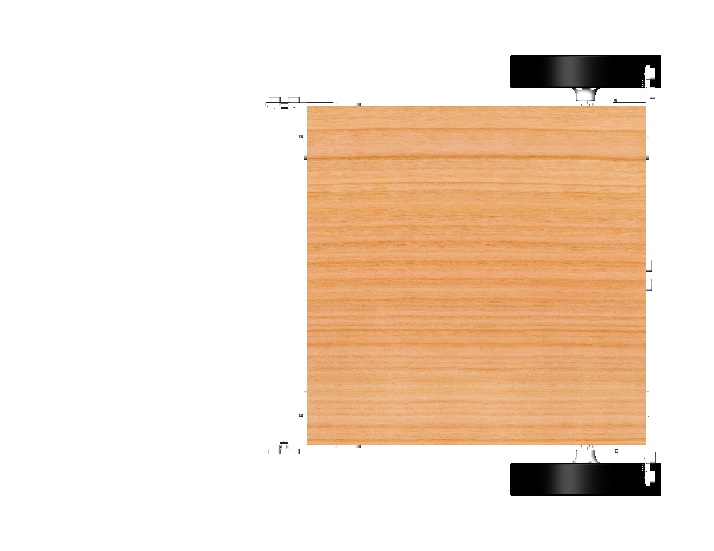
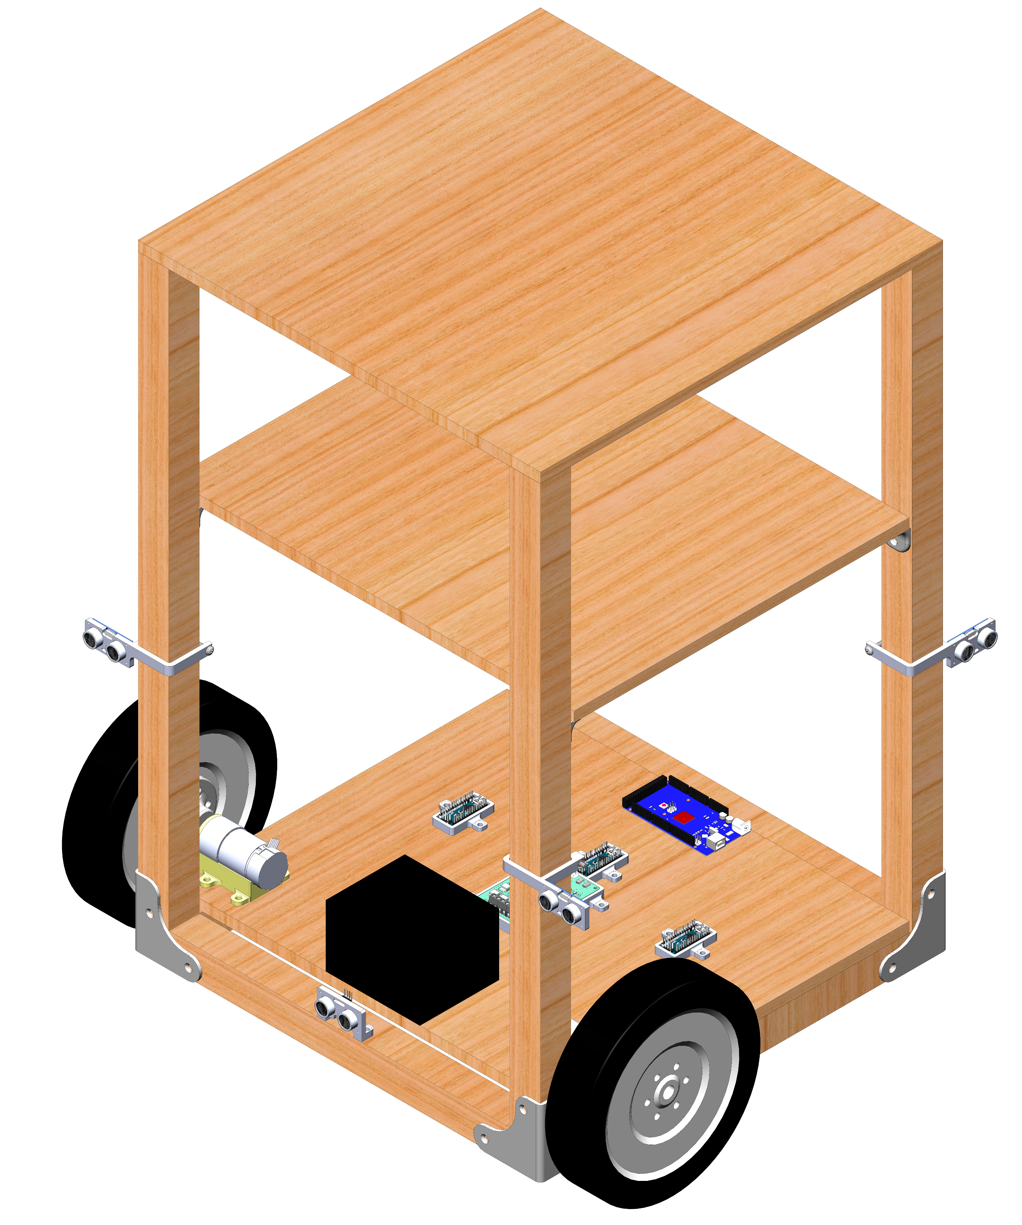
Design and Prototype of an Autonomous Shopping Cart
Siddharth Kurwa, Cockrell School of Engineering, siddharth.kurwa@gmail.com, Fall 2018
Background
Control System Architecture
Obstacle Avoidance Logic
To tune the motor PID controllers, the Ziegler-Nichols tuning method was used. This method allows for experimental determination of the PID parameters (K_{P}, K_{I}, and K_{D}) to maximize response time and eliminate steady-state error while maintaining system stability.
Disturbance
+
+
PID
Left Motor
+
-
-
4
5
6
Proximity Sensor Array
Setpoint Selector
Encoder Feedback
+
PID
Right Motor
-
3
Encoder Feedback
Obstacle
7
Project Goals
2
Semester goals:
Long-term goals:
Gyro Feedback
1
8
9
Closed-loop speed control is achieved with encoder feedback of each motor. However, motor speed differential is insufficient to determine heading of the system in slip conditions. Therefore, a gyro provides closed-loop heading control.
[PLACEHOLDER FOR PID TUNING IMAGES]
Cart approaches obstacle and forward proximity sensors detect obstacle.
Cart performs a 90° turn using gyro feedback.
Cart moves forward until rear right proximity sensor crosses obstacle.
Cart performs a -90° turn using gyro feedback.
Cart moves forward until rear right proximity sensor crosses obstacle.
Cart performs -90° turn using gyro feedback.
Cart moves forward until rear right proximity sensor detects obstacle.
Cart performs a 90° turn using gyro feedback.
Cart moves forward along initial path.
Conclusions and Future Work
Mechanical Design
The functional prototype demonstrates the basic features required of a fully-functional autonomous shopping cart. The primary project goals have been achieved as the system is capable of performing obstacle avoidance, carrying groceries, and carries sufficient onboard processing power to enable further testing of further features.
Improvements to make to the existing system:
Add a bearing on a pillow-block between the motor and wheel hub. This will reduce the bending moment and shear load that the motors currently react and increase the maximum load-bearing capacity.
Mount ultrasonic sensors on a continuous servomotor or use LiDAR to provide 360° proximity detection. In the existing system, there are several “blind-zones” that are not monitored for potential obstacles.
Develop and implement more functional avoidance algorithms to allow smoother path-planning around obstacles rather than the combination of 90° turns and straight-line motion.
New features to incorporate:
Investigate indoor localization sensing capabilities. Several off-the-shelf options exist including PixyCam, bluetooth transmitters/receivers, and Wi-Fi.
RFID sensors and onboard payment terminals to enable monitoring of items in the cart and simplify the payment process.
To tune the motor PID controllers, the Ziegler-Nichols tuning method was used. This method allows for experimental determination of the PID parameters (K_{P}, K_{I}, and K_{D}) to maximize response time and eliminate steady-state error while maintaining system stability.
Distributed Computing over I²C Network
Grocery storage
Proximity sensor measurement and setpoint determination,
Arduino Nano (slave),
Polling at 4 Hz
Wheel velocity setpoints
Motor driver
Arduinos
PID controller,
Arduino Mega (master),
Polling at 50 Hz
Measured
velocity
Measured
velocity
Left wheel drive signal
Right wheel drive signal
Acknowledgements
DC gearmotor
Left wheel velocity measurement and motor drive,
Arduino Nano (slave),
Interrupt-based
Right wheel velocity measurement and motor drive,
Arduino Nano (slave)
Interrupt-based
I deeply appreciate Dr. Carolyn Seepersad’s support of this project. Her advice and feedback were beneficial to the completion of this project.
Sealed lead acid battery
Further Information
Ultrasonic proximity sensors
At a normal walking speed of 5 ft/s, each encoder clicks at a 3500 Hz frequency. Further, each proximity sensor requires a minimum 50 ms delay as its operation is limited by the speed of sound. If these tasks were handled serially by a single controller, the PID loop rate would be extremely limited by the high controller transport delay. To improve dynamic system stability and response time with changing setpoints, computational tasks were distributed over 4 Arduino microcontrollers and communicated over I²C protocol. By managing tasks in parallel to minimize transport delay, the system achieved a 50 Hz PID loop rate.
CAD, source code, BOM, documentation: https://github.com/skurwa/smart-cart
To learn more about Sid: https://skurwa.github.io
The device design was modeled on a differential drive robot with one driven caster and two driving wheels. The controllers, power storage, and drive units are all stored on the bottom platform to maximize usable grocery storage volume. This functional prototype has a wooden construction and uses 3D-printed brackets, fixtures, and mounting adapters.
References
Zafari, F., Gkelias, A., & Leung, K. K. (2018). A Survey of Indoor Localization Systems Technologies
(Rep. No. 1709.01015). https://arxiv.org/pdf/1709.01015.pdf

